Slide 1
Machine Learning
Introduction
Alexandre Quemy
IBM Analytics

Slide 2
AGENDA
Foreword on this ML lectures What is and what is not Artificial Intelligence?
What is Machine Learning?
The different methods
Machine Learning in practice
Future agenda

Slide 3
Foreword on this ML lectures

Slide 4
About the lectures
The objectives in general:
Theory before practice:
Using tools is easy... understanding how and why it works is less easy...
Recognizing a ML problem
Selecting the proper theoretical framework (type of method)
Evaluating the hypothesis to use the model on the data
Evaluating the performances of your model: validation, metrics, model selection,...
Method-based approach rather than problem-based approach:
One lecture per method/framework/paradigm
First lecture on the problems, vocabulary and taxonomy

Slide 5
About the lectures
The objectives of the first lecture (this one!):
Clarifying few points and defining the basis:
General presentation of AI: history, what is ML,...
Informal and formal optimization framework formulation
The taxonomy of Machine Learning frameworks
The typical problems in Machine Learning
Some vocabulary related to ML (e.g. generative vs discriminative)
Some (of the main) pitfalls related to: exploration vs exploitation, bias-variance tradeoff, no-free lunch theorem, ...
At the end, you should:
be able to follow the next lecture :-)
be impressive at a family diner
recognize IA and ML quacks in the media*
* Spoiler: They are numerous.

Slide 6
What is and is not
Artificial Intelligence?

Slide 7
Artificial Intelligence
What is not Artificial Intelligence and few other misconceptions:
Misconception 1. Unified Magical Back-box
A.I. is not a black-box or a unified framework to solve all the problem: it is a collection of disjoint, sometimes incompatible theories and tools to solve specific and restricted problems.

Slide 8
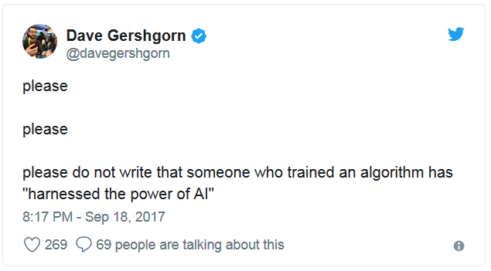
Artificial Intelligence
What is not Artificial Intelligence and few other misconceptions:
Misconception 2. Human replacement / Easiness to use
The application of A.I. requires at least as much engineering as non A.I. IT solutions: the advantage is in the efficiency in the exploitation cycle over humans.

Slide 9
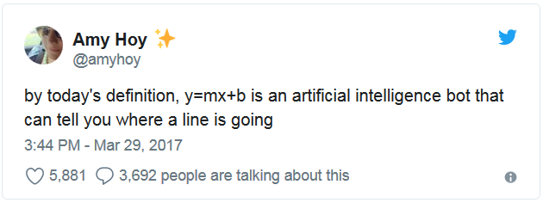
Artificial Intelligence
What is not Artificial Intelligence and few other misconceptions:
Misconception 3. Gap industry / research
Neural Networks are OLD. VERY OLD.
Deep Learning is not the Holy Grail: → Supervised → Very slow → Extremely specialized algorithms e.g.: AlphaGo Zero’s secret is Reinforcement Learning + 25 million dollars worth of computational power → Nothing new but a nice engineered PoC and media attention. Not only my opinion: https://medium.com/@josecamachocollados/is-alphazero-really-a-scientific-breakthrough-in-ai-bf66ae1c84f2

Slide 10
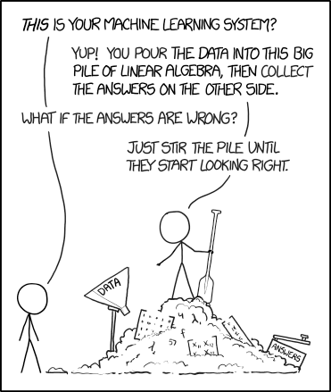
Artificial Intelligence
What is not Artificial Intelligence and few other misconceptions:
Misconception 4. „Lost in translation”
The Intelligent in A.I. must be understood as the Intelligent in C.I.A. and not as in ‚‚this guy is so smart, I wish I could be as intelligent as him’’.

Slide 11
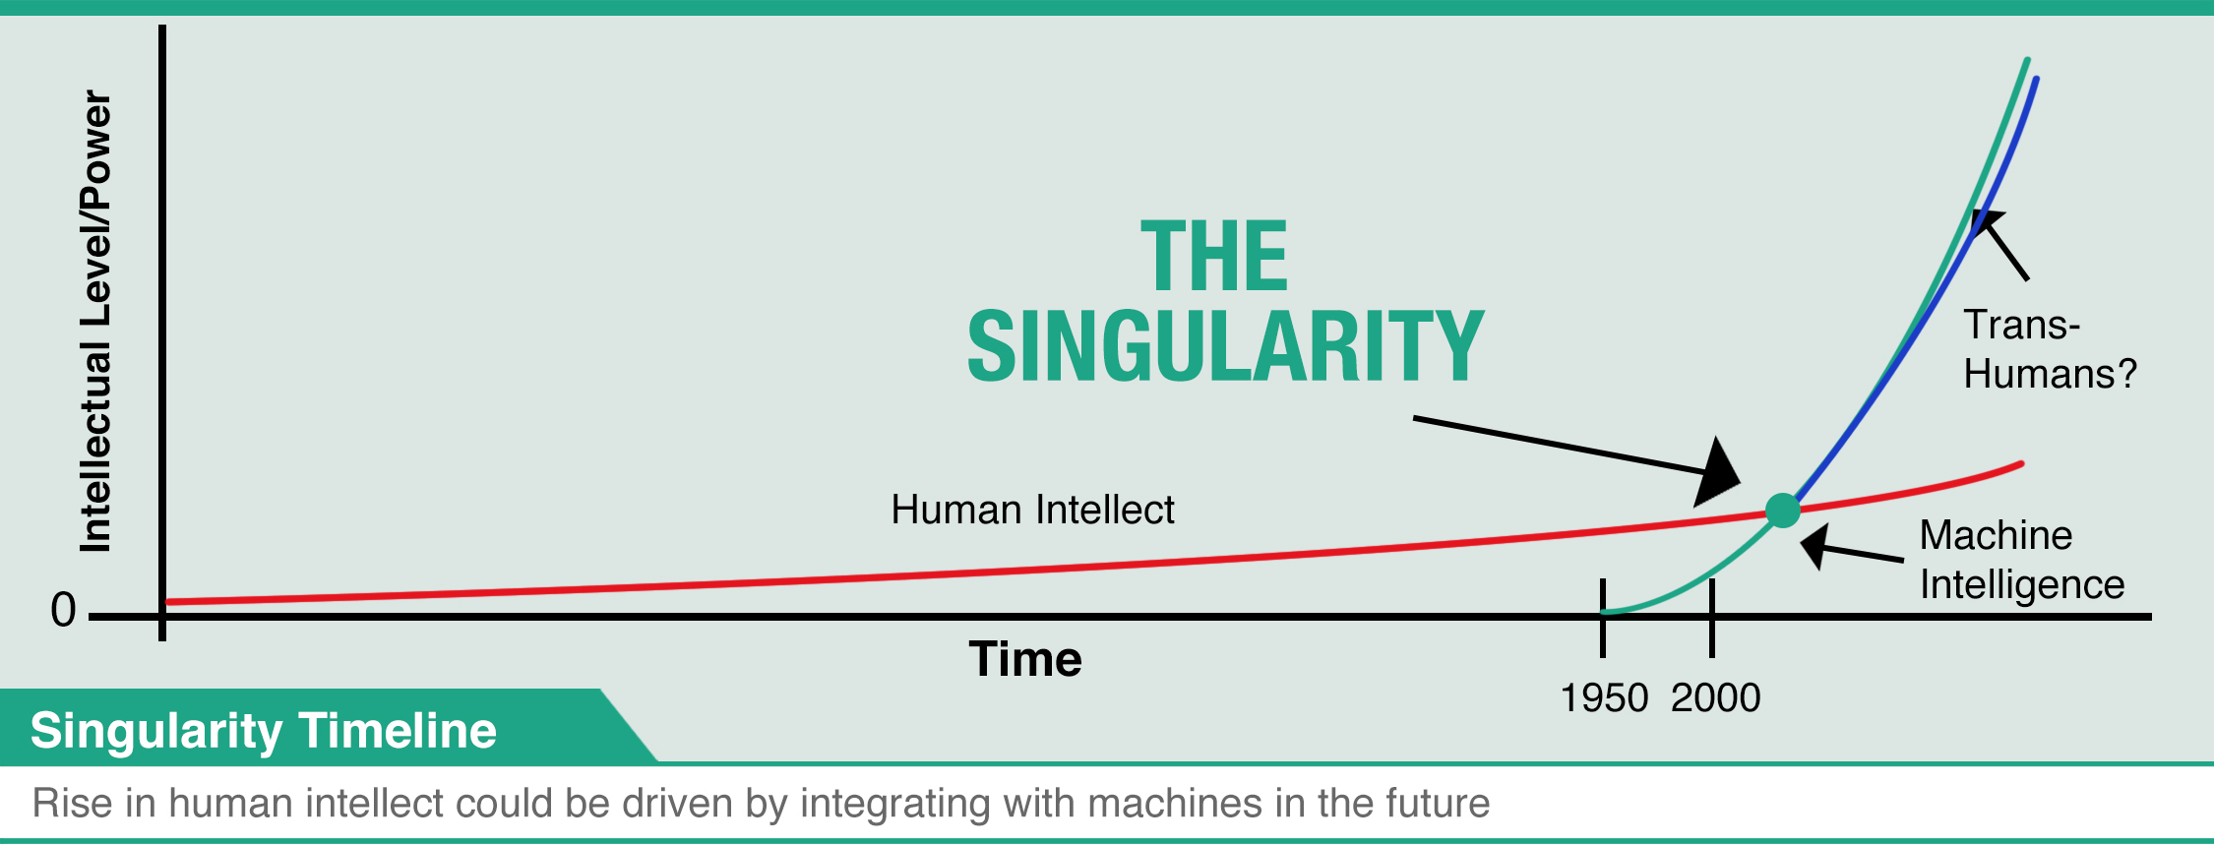
Artificial Intelligence
What is not Artificial Intelligence and few other misconceptions:
Misconception 5. „The Singularity”
A lot to say... Usually para-science.

Slide 12
Artificial Intelligence
What is not Artificial Intelligence and few other misconceptions:
Misconception 6. „The Singularity”
Interesting subject, mixing philosophy and real science:
→ Functionalist materialism hypothesis (~Turing test)
→ Ref: David Kellogg Lewis, David Malet Armstrong
But here, we exclude copying human behavior as part of A.I.:
→ Common assumption in „A.I” research community.

Slide 13
Artificial Intelligence
As many definitions as researchers:
Study of cognitive capacities using computational-based methods (Charniak et McDermott, 1985)
Conception of intelligent agents (Poole et al., 1998)
Field studying the possibility for a computer to perform tasks for which humans are better today than the machine (Rich et Knight, 1990)
Automation of activities associated to human reasoning such as decision, problem solving, learning (Bellman, 1978)
Study of mecanism enabling an agent to perceive, reason and act (Winston, 1992)
Study of entities with an intelligent behavior (Nilsson, 1998)

Slide 14
Artificial Intelligence
A small history of A.I.:
Gestation of A.I. (1943-1955): McCulloch et Pitts introduced the neural model. Hebb proposed a method to modify the connections. Minsky and Edmond built the first Neural Networks. Turing introduced the Turing test.
Birth of A.I. (1956): Dartmouth Summer Research Project on Artificial Intelligence
Growing hopes (1952-1969): Fast expansion and a lot of results (General Problem Solver by Newell and Simon, Logic Theorist by Newell and Simon, Geometry Theorem Prover by Gelernter)
First disappointments (1966-1973): 1966: Failure from automatic translation 1969: Failure from Neural Network by... Minsky and Papert!

Slide 15
Artificial Intelligence
A small history of A.I.:
Expert systems (1969-1979): DENDRAL: determine structure of a molecule based on its formula and spectrogram. MYCIN (medical), HYPO (legal domain), etc...
A.I. in the industry (1980-today): DEC started to use Expert System to reduce costs, followed by many others... The industry started to set up research and operational teams in A.I.. The nations (U.S., Japan, U.K.) renewed their funding programs.
The comeback of neural network (1986-today) Independant (re)discovery of the back-propagation rule allowing to overcome the limit of classic neural networks.

Slide 16
Artificial Intelligence
A small history of A.I.:
Modern IA (1987-today) Breakthrough of Neural Networks in 2012: ImageNet Classification with Deep Convolutional Neural Networks, by Alex Krizhevsky, Ilya Sutskever, and Geoffrey Hinton, NIPS12 Since then, large focus on deep neural networks, mostly for vision problem at first. But „Neural Network” appears 2 times only in the last JMLR volume (2017). 7 times in 2016, 1 in 2015, 2 in 2014, 0 in 2013...
The future? My bets: → Capsule Networks for Supervised Learning → Unsupervised Learning → Non goal-oriented methods (comeback of metaheuristics and evolutionary computation) → Hypergraph Case-Based Reasoning (or not ☺)

Slide 17
What is Machine Learning?

Slide 18
What's the difference between AI and ML?
It's AI when you're raising money, it's ML when you're trying to hire people.
And it's optimization & statistics when you get things done.

Slide 19
Machine Learning
Artificial Intelligence
Statistics and Probabilities Data analysis ...
Optimization
Machine
Learning
Control Theory Robotic Command
Vision

Slide 20
Machine Learning
Let us define Machine Learning:
Capacity of a system to improve its performances by the interaction with its environment.
A familly of Artificial Intelligence methods: techniques for automated conception and adaption of intelligent agents.

Slide 21
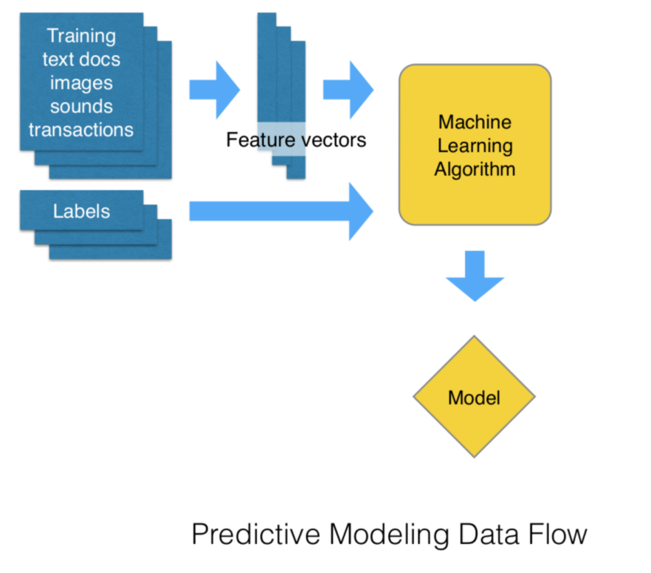
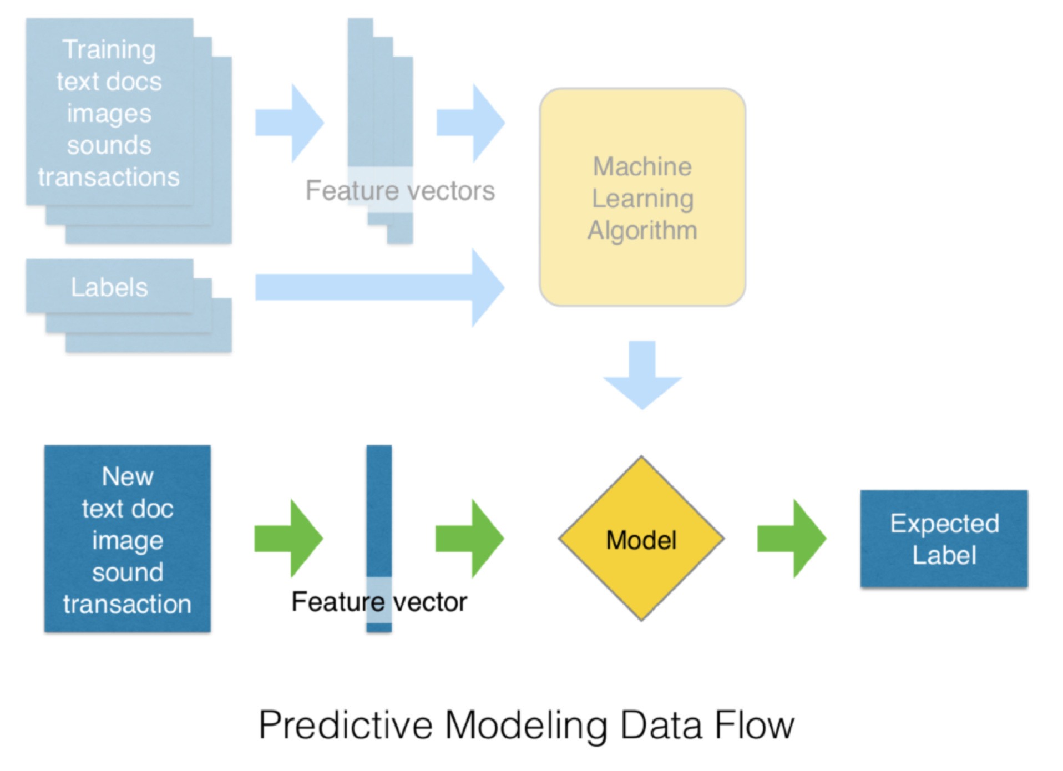
The Big Picture

Slide 22
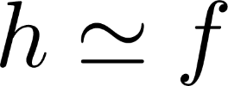
Machine Learning
Let us define Machine Learning:
Ouput vector space
Input vector space
The exact mapping f is unknown
Machine Learning problem: find such that *
Machine Learning algorithm: a method to find or build
* Not very formal

Slide 23
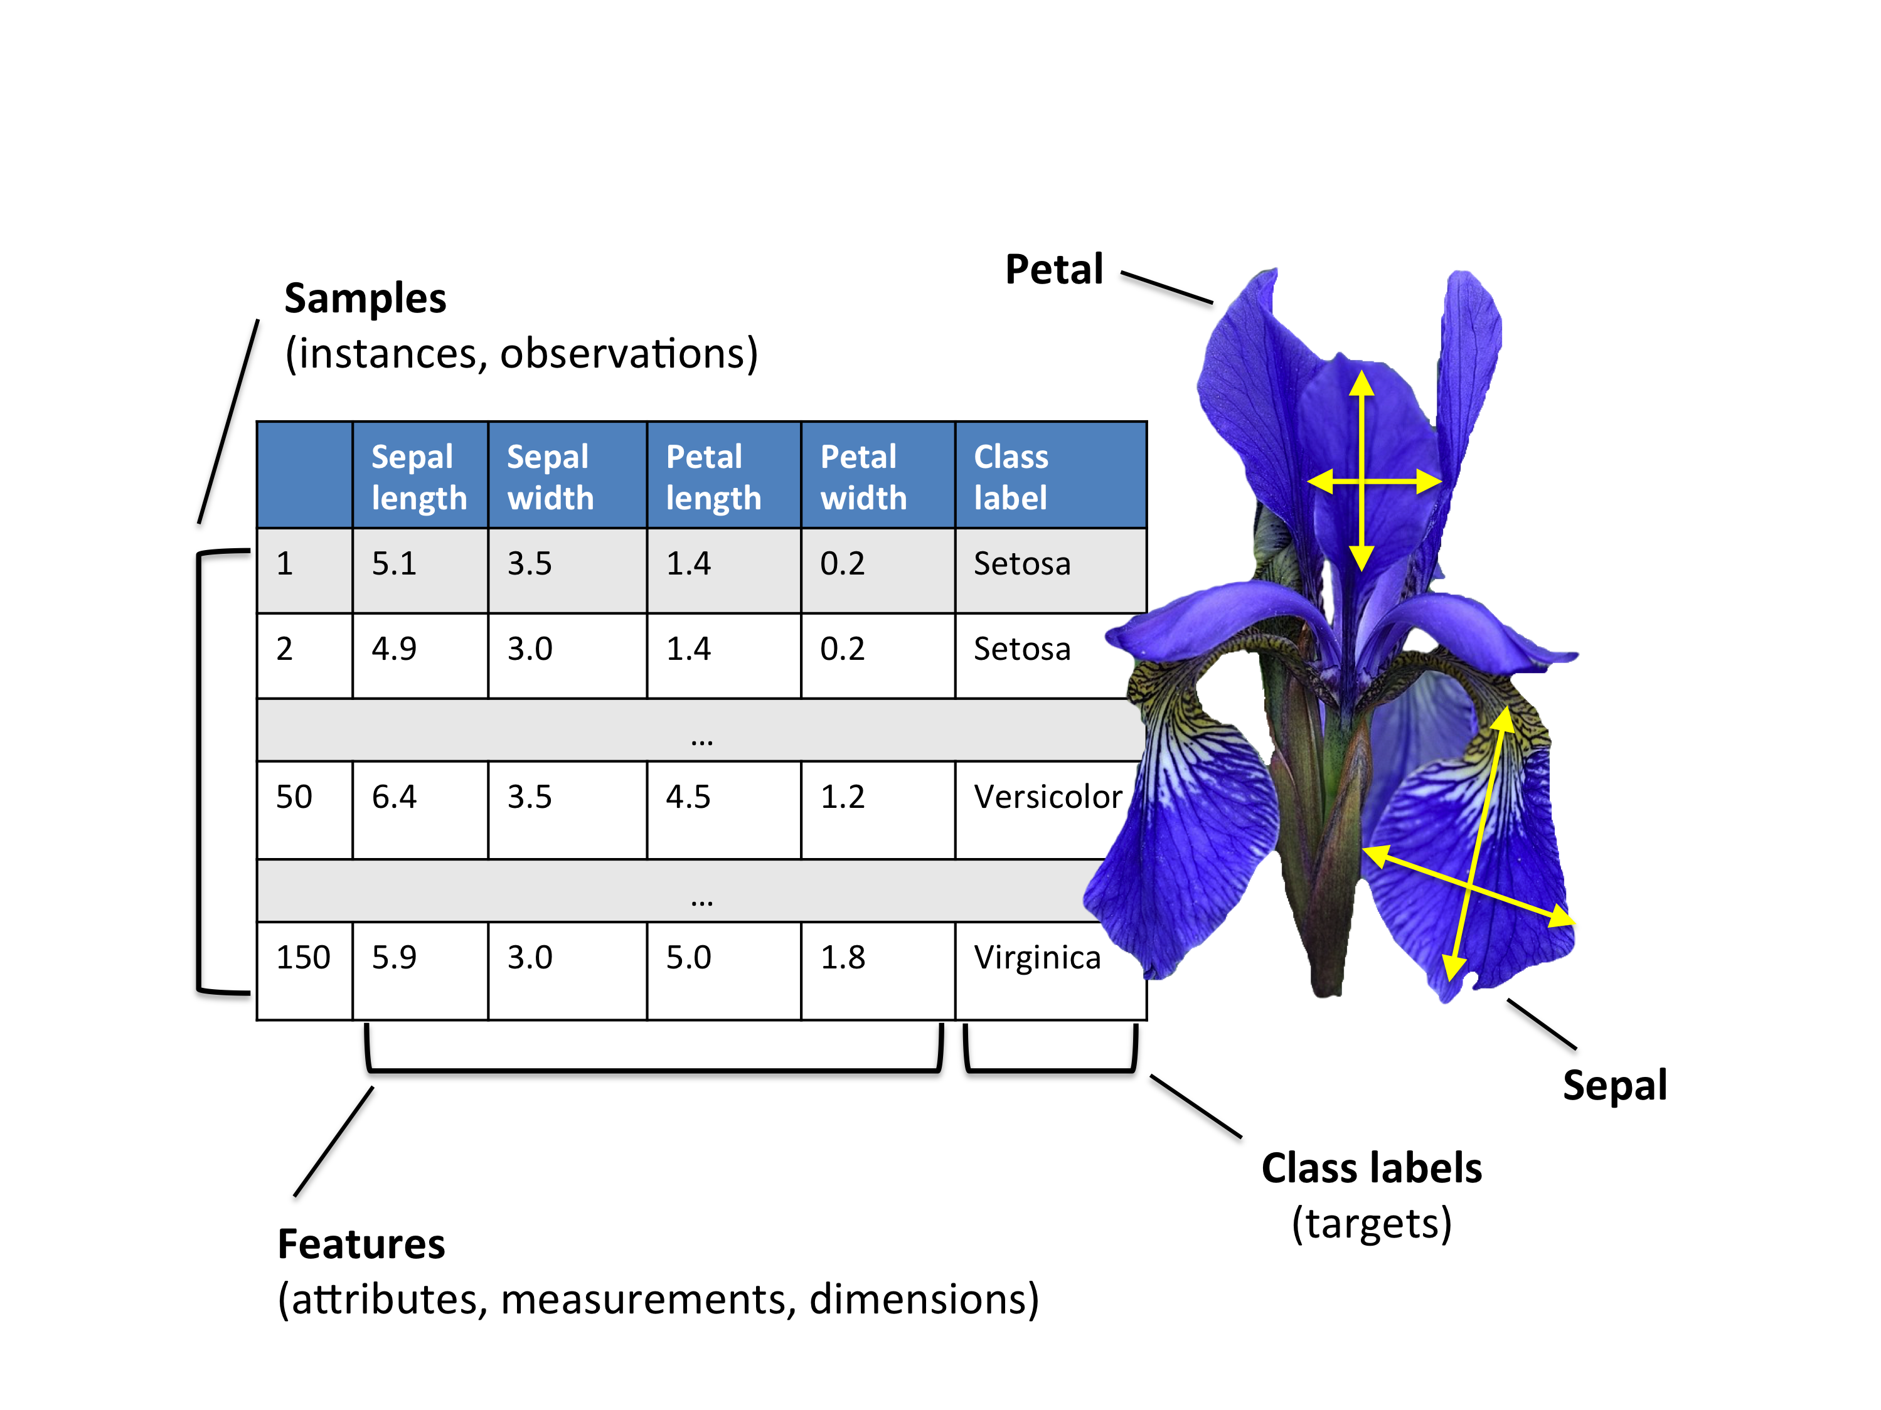
Machine Learning
Example 1:
Three classes:
Iris Setosa
Iris Versicolour
Iris Virginica
.
.
.

Slide 24
Machine Learning
Machine Learning problem: find such that *
Many problems:
Infinite number of possible functions we need to restrict the space where lives to
But still, how to I select or build one model? we need data i.e. „hints” or information on
But still, how do I evaluate my model (i.e. how close is it from ) we need data i.e. „hints” or information on
Hypothesis
ML Algorithm
Data
The type of information changes everything!

Slide 25
Machine Learning
Machine learning paradigm:
A model or hypothesis space e.g.: Specific mathematical function class (polynomial, decision tree,...)?
Data collection e.g.: Examples with correct output, examples without correct output, etc.
Cost function to optimize e.g. Number of wrongly classified examples in classification, etc.
An algorithm to modify the model from the data s.t. it minimizes the cost function e.g. Gradient, exact method, heuristic, etc.
The algorithm is searching in the best model depending on the available data

Slide 26
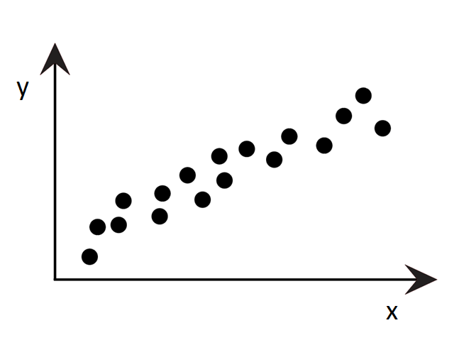
Machine Learning
Model Space: set of affine function, i.e. we assume
Interaction / input data: a collection of n points
Cost function: the sum of the squares of the residuals
Algorithm: direct of iterative resolution of the linear system (in higher dimension)
The problem can be seen as a model selection problem: selecting the best affine function among the set of all affine functions!
Example 2: Least Squares Regression

Slide 27
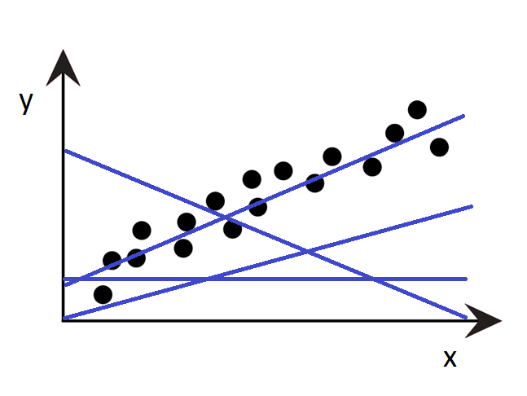
Machine Learning
Example 2: Least Squares Regression
Few possible models...

Slide 28
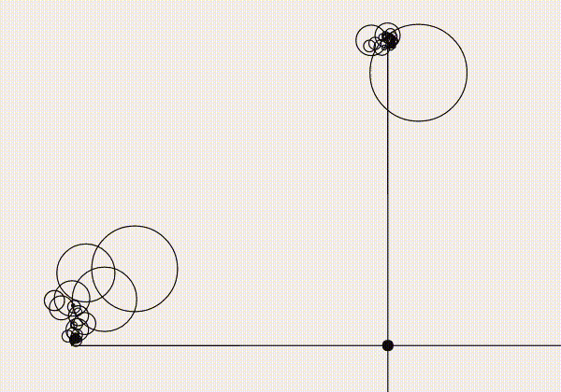
Machine Learning
On the importance of a good hypothesis space

Slide 29
The different problems

Slide 30
The different problems
The main problems:
Classification: → I want to learn how to classify the points in X according to the classes Y.
Regression: → I want to predict a new value in Y based on the input values in X.
Clustering: → I want to group my points in X such that the points in a group are similiars.
Dimensionality Reduction / Feature selection: → I want to learn what are the important dimensions of X in the mapping to Y.

Slide 31
The different problems
The main problems:
Association rule: → I want to learn explicit rules that are used to map elements of X in Y.
Control: → I want to learning how to move the points in X in an optimal way.

Slide 32
Methods classification
Classification from input data to method:
Classification by the input data: → I have a training set with the expected output: Supervised Learning → My training set is not labelled: Unsupervised Learning → My training set is partially labelled: Tricky (usually, Semi-Supervised Learning) → I do not have training set: Reinforcement Learning The problems to solve ARE not the same!
Remark: There exists some variations but they can more or less fit the classification: → PU-learning → N-Shot learning → 0-Shot learning

Slide 33
Machine Learning
Classification from input data to method: Classification by the output data:
Input Output Problem
Continous
Regression
Supervised
Categorical
Classification
Clustering
Unsupervised
Non-available
Association
Classification
Semi-Supervised
Categorical
Clustering
Categorical
Classification
Reinforcement
Non-available
Control

Slide 34
Machine Learning
A couple (input/output) defines a problem and thus different methods to solve it.
Additional useful characterization: Classification based on the data used by the model: → It uses information on the input space distribution and output: Generative → It uses only information about the outputs: Discriminative When the training data must be available? Can I update the model? → The model is selected on a fixed training set: offline → The model is built by receiving new pairs (x,y): incremental → The model can evolve with new inputs (without label): online New „buzzword” for online and incremental learning: Continuous learning

Slide 35
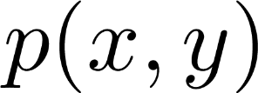
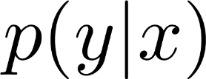
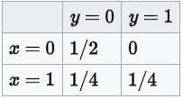
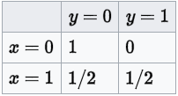
Discriminative vs Generative models
An example:
Generative
Discriminative

Slide 36
Continuous Learning
An example: Given an training set (X,y):
With in general
Offline:
Incremental:
Online:

Slide 37
Supervised Learning

Slide 38
Supervised Learning: Definition
Formal definition:
Input vector space (often ) Output space: (often )
Training set: with and
Generalization error: where is the probability distribution of and a given norm on .
Supervised Learning problem:

Slide 39
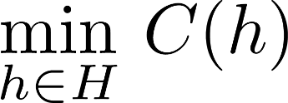
Supervised Learning : Definition
Formal definition:
In practice, we can only calculate the empirical generalization error
This lead to the most common framework for supervised learning: with where is the structural risk (or regularizartion) and penalizes model complexity. (Philosophically related to the Ockham razor)

Slide 40
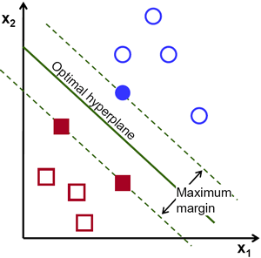
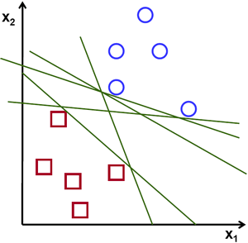
Supervised Learning: Definition
Type of Supervised Learning methods:
By maximization of margin: → Support Vector Machine
A hyperplan is characterized by its weights, i.e. enough to look for but how to define the cost function?
with m the margin

Slide 41
Supervised Learning: Definition
Type of Supervised Learning methods:
By maximization of margin: → Support Vector Machine
A hyperplan is characterized by its weights, i.e. enough to look for but how to define the cost function?
Hinge Loss: Support Vector Machine
0-1 Loss: Perceptron (Single Layer Neural network)
Log Loss: Logistic Regression

Slide 42
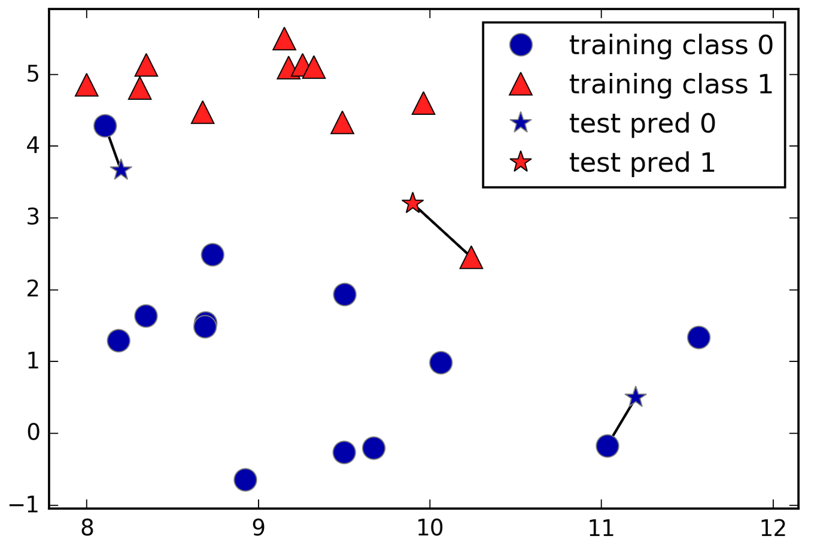
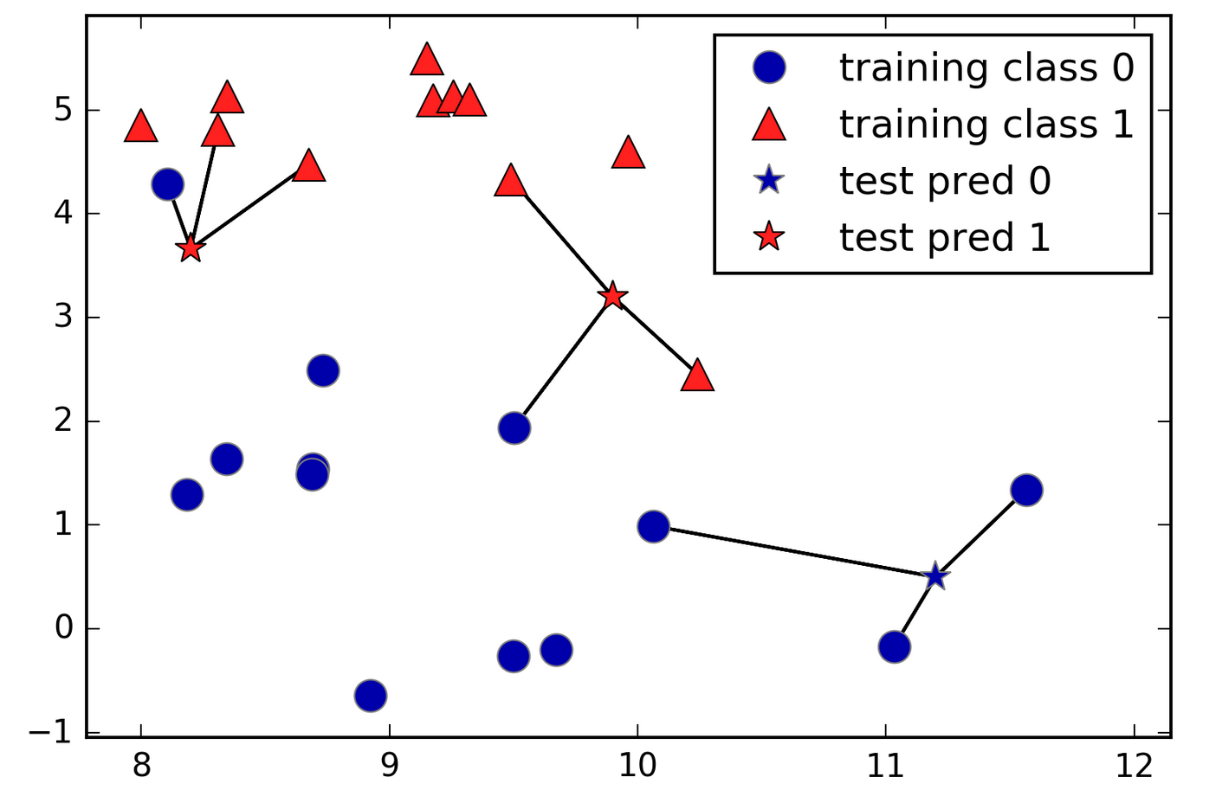
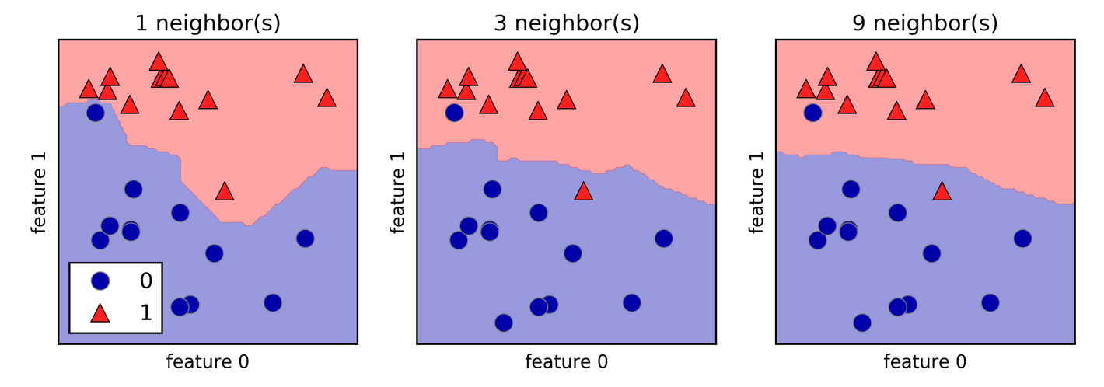
Supervised Learning: Definition
Type of Supervised Learning methods:
By analogy: → Nearest Neighbors
Euclidian
Manhattan:
Minkowski

Slide 43
Supervised Learning: Definition
Type of Supervised Learning methods:
By probability inference: → Bayesian: Naive Bayes, Likelihood Estimation
the set of conditional probabilities over (conditionned by )
Estimation of parameters based on training data. Requires likelihood estimation (e.g. MLE).
Likelihood
Class prior probability
Very strong hypothesis („naive”)
Predictor prior probability

Slide 44
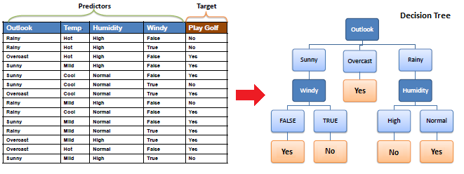
Supervised Learning: Definition
Type of Supervised Learning methods:
By combination of elementary tests: → Tree: Binary Decision Tree → Ponderated vote: Boosting
set of trees

Slide 45
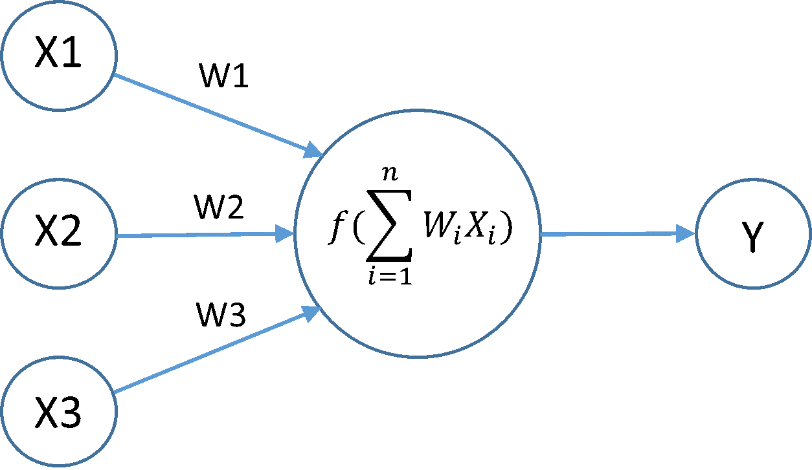
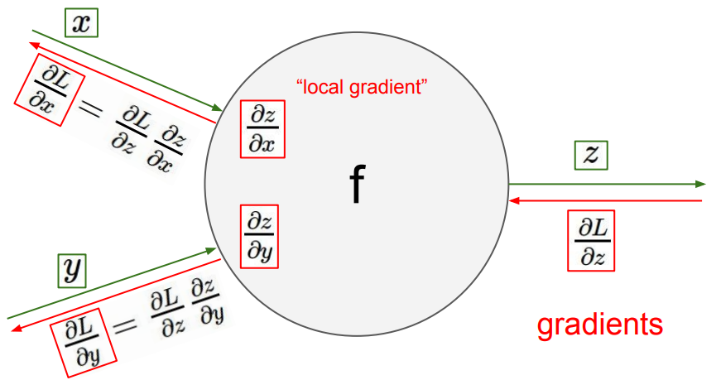
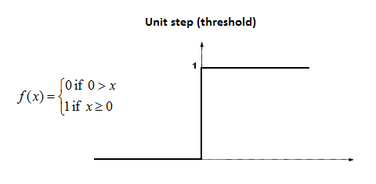
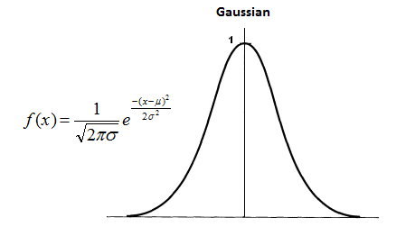
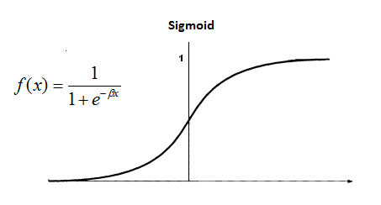
Supervised Learning: Definition
Type of Supervised Learning methods:
By error minimization: → Neural Network
Model training:
Modifying the weights such that the cost function is minimized
The universal algorithm: backpropagation
The choice of the cost function is important w.r.t. backpropagation theoretical properties
Model space hard to define:
The final output is a convex combination of weights
Weights in a layer i depends on weights in all previous layers
This dependance is not linear (composition of activation functions)

Slide 46
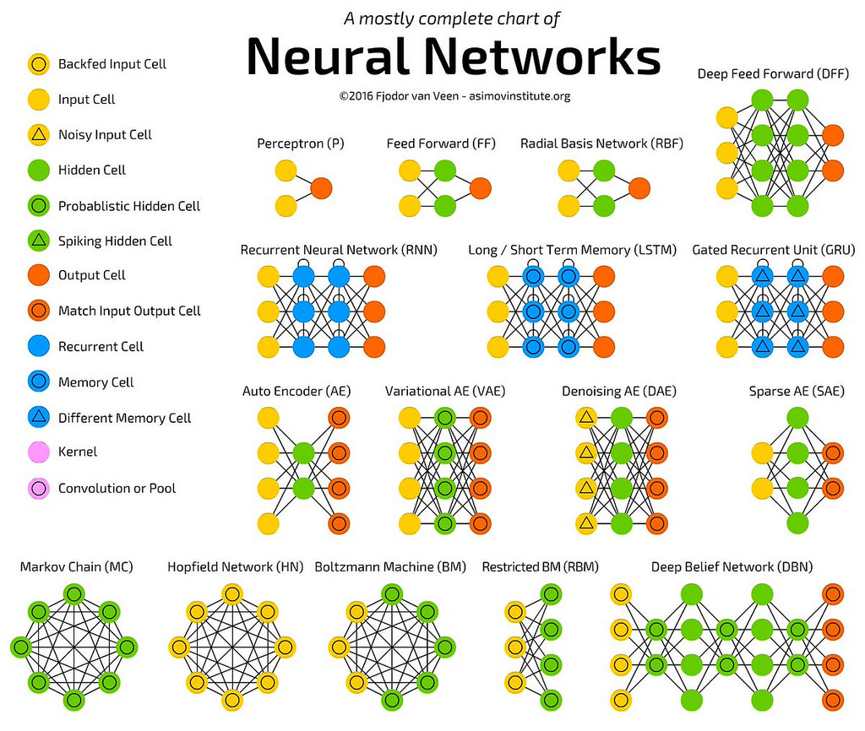
Supervised Learning: Definition

Slide 47
Supervised Learning: Pitfalls
So everything is fine?
No Free Lunch Theorems
Problem of generalization
Bias-Variance tradeoff
The limit of indicators

Slide 48
Supervised Learning: NFL
No Free Lunch Theorems
„even after the observation of the frequent or constant conjunction of objects,
we have no reason to draw any inference concerning any object
beyond those of which we have had experience”
Hume (1739–1740)
Supervised machine learning (Wolpert 1996)
Training set of size n Function to learn Algorithm’s guess for f made in responde to D Generalization error
all algorithms are equivalent, on average, by any of
the following measures of risk:
How well you do is determined by how ‘aligned’ your learning algorithm with the actual postorior

Slide 49
Supervised Learning: NFL
No Free Lunch Theorems
„even after the observation of the frequent or constant conjunction of objects,
we have no reason to draw any inference concerning any object
beyond those of which we have had experience”
Hume (1739–1740)
No Free Lunch for Search/Optimization (Wolpert and Macready 1997)
All algorithms that search for an extremum of a cost function perform exactly the same when averaged over all possible cost functions. So, for any search/optimization algorithm, any elevated performance over one class of problems is exactly paid for in performance over another class.

Slide 50
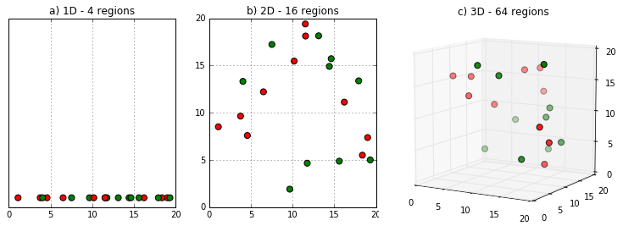
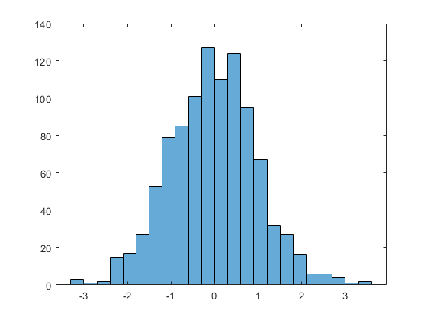
Supervised Learning: Curse of Dimensionality
Curse of Dimensionality
Various phenomena appear in large dimensional spaces.
Examples: n=100, d=1 (assume [0,1]) versus n=100, d=10 ([0,1]^d)
?

Slide 51
Supervised Learning: Curse of Dimensionality
Curse of Dimensionality
Various phenomena appear in large dimensional spaces.
Examples: „Measure concentration” When the dimension increases, the distance between two points tends toward the average distance between two points. It becomes impossible to determine „short” and „long” distance.
Take n points randomely generated in and a random reference point:

Slide 52
Supervised Learning: Fitting and Generalization
Overfitting:
We want to learn a function over based on a ! Not only on .
Overfitting happends when the model h created is more complex than f. Consequence: The performance does not improve or deteriorate! Solutions:
Chose a better sample x when possible (if possible)
Stop earlier the algorithm to select the model
Change the hypothesis on the model
Input vector space

Slide 53
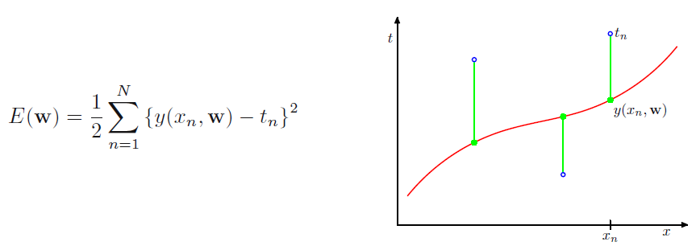
Supervised Learning: Fitting and Generalization
Example 3: polynomial regression:

Slide 54
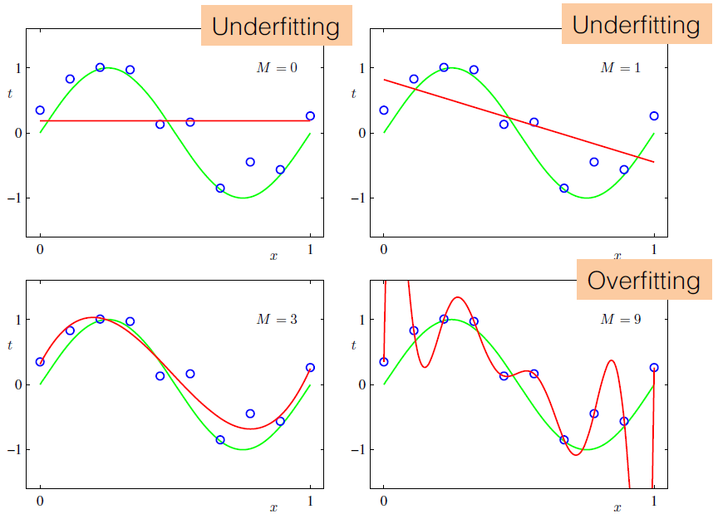
Supervised Learning: Fitting and Generalization
What degree M for the polynomial ?
Theorem: for any set of M+1 points, there exists a unique polynomial of degree M that passes exactly through every point.

Slide 55
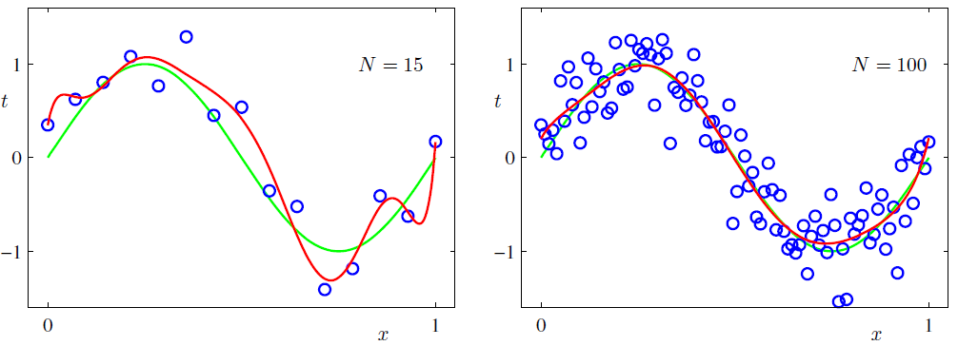
Supervised Learning: Fitting and Generalization
The role of BigData:
M=9
M=
9
The overfitting decreases with dataset!

Slide 56
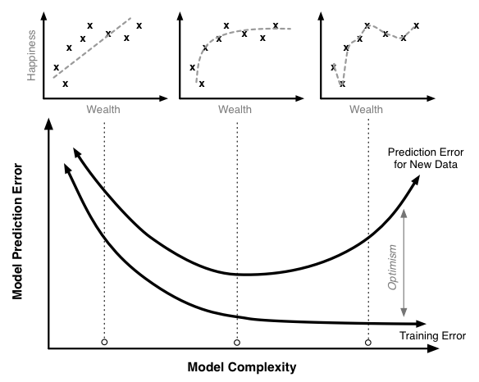
Supervised Learning: Model Complexity
Impact of model complexity on prediction error

Slide 57
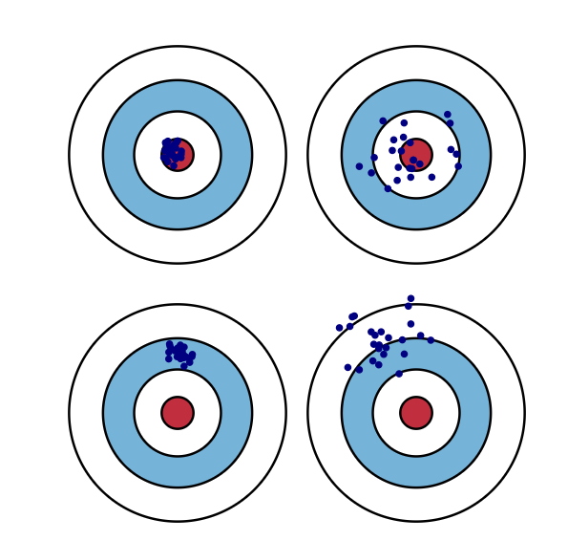
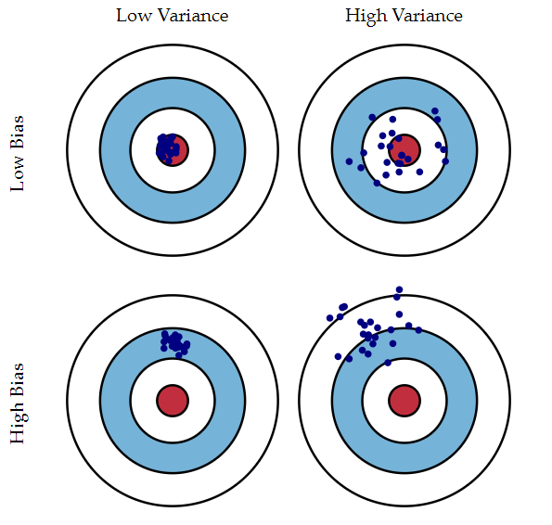
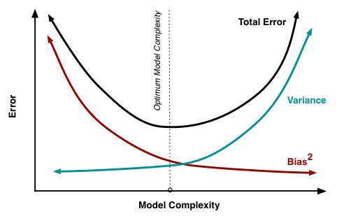
Fitting and Generalization
The Bias-Variance tradeoff
Bias
Variance
Irreducible error

Slide 58
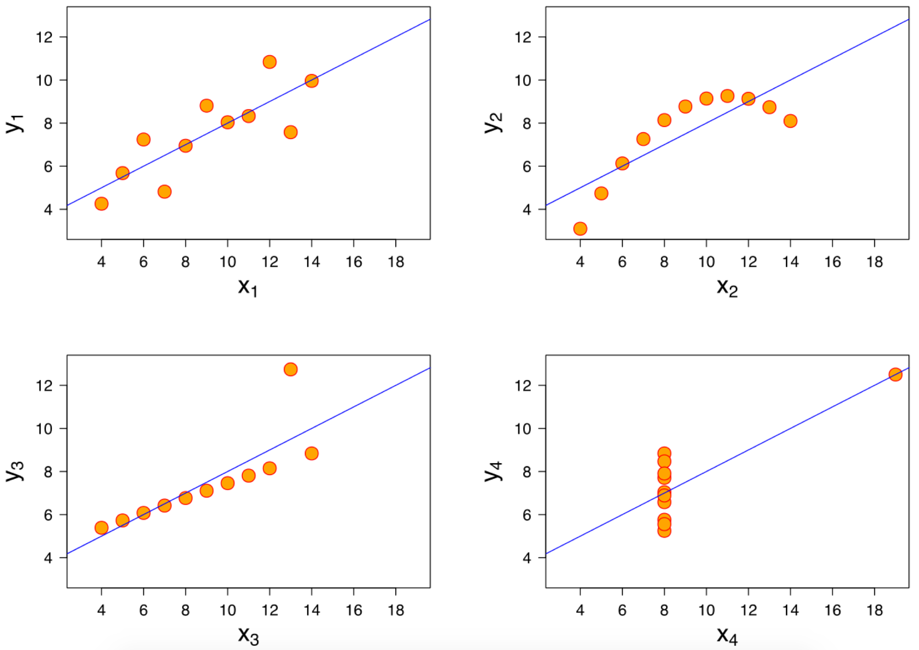
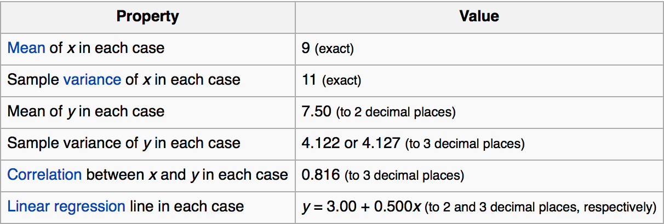
Humans are needed!

Slide 59
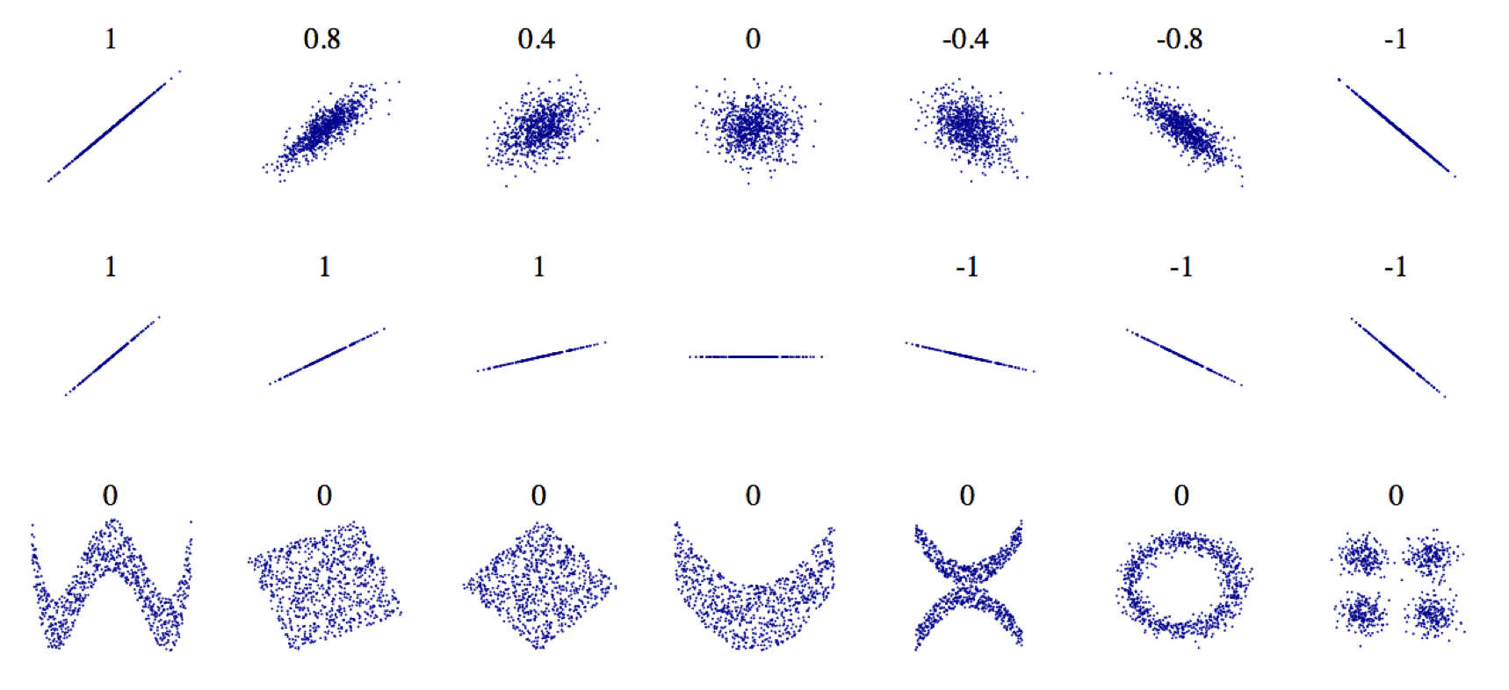
Humans are really needed!

Slide 60
Unsupervised Learning

Slide 61
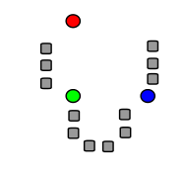
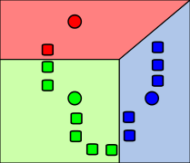
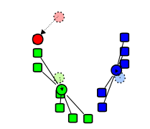
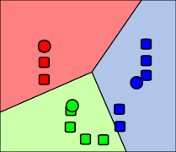
Machine Learning
Type of Unsupervised learning:
By analogy: → Hierarchical clustering: k-means clustering

Slide 62
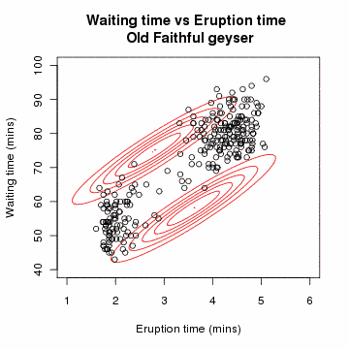
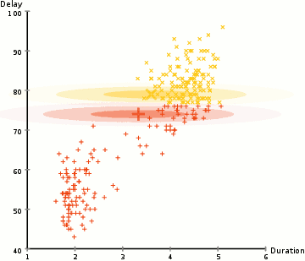
Machine Learning
Type of Unsupervised learning:
By parameter or density estimation: → Latent parameter estimation: expectation–maximization (EM)

Slide 63
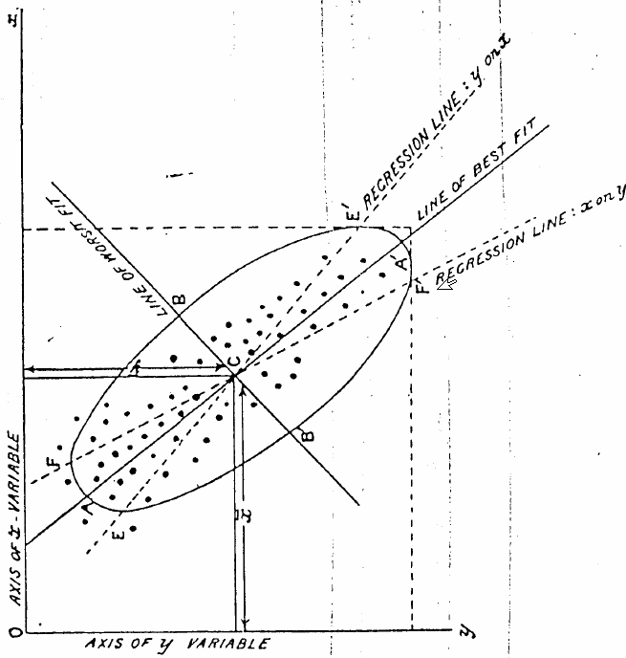
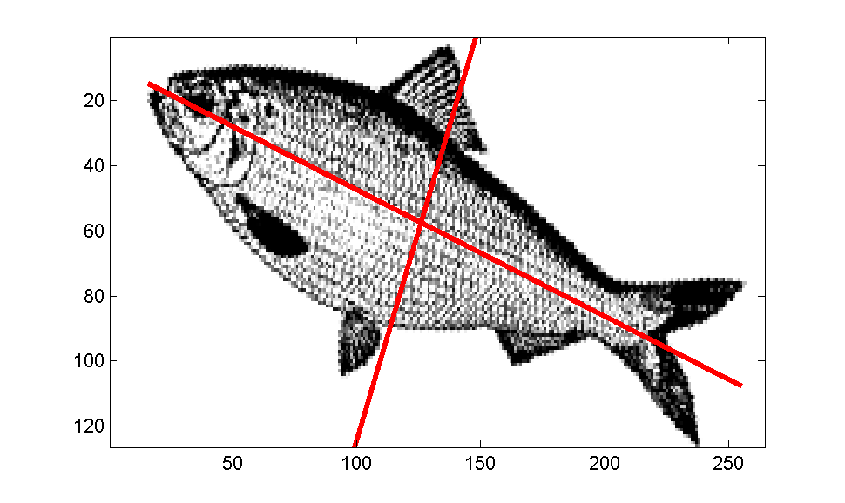
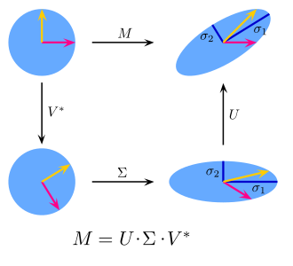
Machine Learning
Type of Unsupervised learning:
By parameter or density estimation: → Dimensionality reduction: PCA, SVD

Slide 64
Semi-supervised Learning

Slide 65
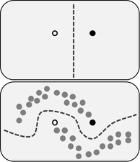
Semi-Supervised Learning
The benefit of Semi-Supervised in one picture:
Most methods are derivated from (Un)Supervised learning.
Very close from how humans learn: few direct examples (e.g. parental labelling) lots of unlabeled situations
Assumptions:
Continuity: close points are likely to share the same label
Cluster: the points tends to form discrete clusters
Manifold: the data can be approximated by a low-dimensional manifold

Slide 66
Transductive vs. Inductive
Induction: → Learning a function from → Building a universal model i.e. a generalization → Most approaches as the main ML framework is inductive
Transduction: → Learning a function from → Building a restricted model → Gain in popularity and research attention lately
When solving a problem of interest, do not solve a more general problem as an intermediate step. - Vladimir Vapnik
What is the difference between transductive learning and semi-supervised?
Are transductive problems easier than inductive problems?
What are the restrictions of transductive algorithms?

Slide 67
Machine Learning in Practice

Slide 68
Machine Learning
Traditional programming:

Slide 69
Machine Learning
Machine Learning as a black-box:

Slide 70
Machine Learning
Programming using Machine Learning:

Slide 71
Machine Learning
Programming using Machine Learning:

Slide 72
Machine Learning
Evaluation metrics:
Time complexity: is my algorithm scalable in time?
Space complexity: is my algorithm scalable in space?
Optimality: does my algorithm converges with data?
Robustness: is my algorithm sensitive to data and (hyper)parameters?

Slide 73
Machine Learning
Machine Learning workflow:

Slide 74
Machine Learning
Machine Learning workflow:

Slide 75
Machine Learning
Scikit-learn
Python ML library
Open source and free
Very active community
Great documentation
Supervised & Unsupervised
Feature engineering
Model Selection
Algorithm pipelines

Slide 76
Machine Learning
Scikit-learn
An efficient language for technical computing
Can match C speed
On a standalone workstation, Scikit-learn is:
4x faster than SPSS modeler
100x faster than R
1.5 to 40 times faster than Spark ML
Scikit-learn provides a unified api for many different algorithms in one package
Spark ML api is modeled after Scikit-learn

Slide 77
Scikit-learn
Apache Spark
Spark ML

Slide 78
Spark Machine Learning
Extract, Transform, Select
Classification and Regression
Clustering
Collaborative Filtering
Model Selection and Tuning

Slide 79
Machine Learning Workflow

Slide 80
ML/Data Science architecture

Slide 81
ML/Data Science architecture

Slide 82
ML/Data Science architecture
Hello

Slide 83
Future agenda

Slide 84
Schrödinger plan
→ Evaluating your model: validation, model selection, metrics,... → Regression and Classification with Linear Models → Dimensionality Reduction and Feature Selection → Support Vector Machines in details → Decision Tree and Random Forest → Ensemble methods (bagging, boosting, ...) → Neural Networks and Deep Learning → Non-parametric models → Reinforcement Learning → Evolutionary Computation
Your help is welcomed!

Slide 85
Bibliography
→ The 9 Deep Learning Papers You Need To Know About
https://adeshpande3.github.io/adeshpande3.github.io/The-9-Deep-Learning-Papers-You-Need-To-Know-About.html

Slide 86
Thank you

